Slide 1
Image sharpening using knowledge distillation
Jeevitha M

Slide 2
Problem Statement & Motivation
Problem
Real-world images often suffer from blur and quality degradation
High-performance models (like RealESRGAN) can fix this, but are computationally expensive
Motivation
Enable efficient image sharpening without needing heavy models
Make it suitable for low-resource devices (e.g., mobile, embedded systems)
Use knowledge distillation to transfer knowledge from a deep teacher model to a lightweight student

Slide 3
Dataset & Preprocessing
Dataset
42 real-world RGB images
Images resized to 128×128
Preprocessing
Applied Gaussian Blur to simulate degradation
Input: Blurred image
Target: Original sharp image

Slide 4
Architecture Diagram
Student–Teacher Pipeline
[Blurred Image]
↓
+-------------------+ +------------------+
| Teacher Model | ---> | Sharp Output (T)|
+-------------------+ +------------------+
↓
+-------------------+ +------------------+
| Student Model | ---> | Sharp Output (S)|
+-------------------+ +------------------+
Loss = MSE(S, GT) + MSE(S, T) + SSIM(S, GT)

Slide 5
Model Details
Teacher Model
4-layer CNN
Trained to sharpen blurry images
Parameters frozen during student training
Student Model
Lightweight 3-layer CNN
Learns from both ground truth and teacher output

Slide 6
Algorithm & Training Steps
Input: Blurred image
Teacher Inference: Generates high-quality output (frozen)
Student Inference: Learns to mimic both GT and teacher
Loss Calculation:
MSE(Student, GT)
MSE(Student, Teacher)
1 - SSIM(Student, GT)
Backpropagation using Adam optimizer (lr = 1e-3)
Repeat for multiple epochs

Slide 7
Flowchart
Start
↓
Upload Blurred Images
↓
Preprocess (resize, normalize)
↓
Train Teacher Model
↓
Freeze Teacher
↓
Train Student with Distillation Loss
↓
Evaluate SSIM & PSNR
↓
Visualize Results
↓
End

Slide 8
Results & Metrics
PSNR | 19.19 dB
SSIM | 0.9209

Slide 9
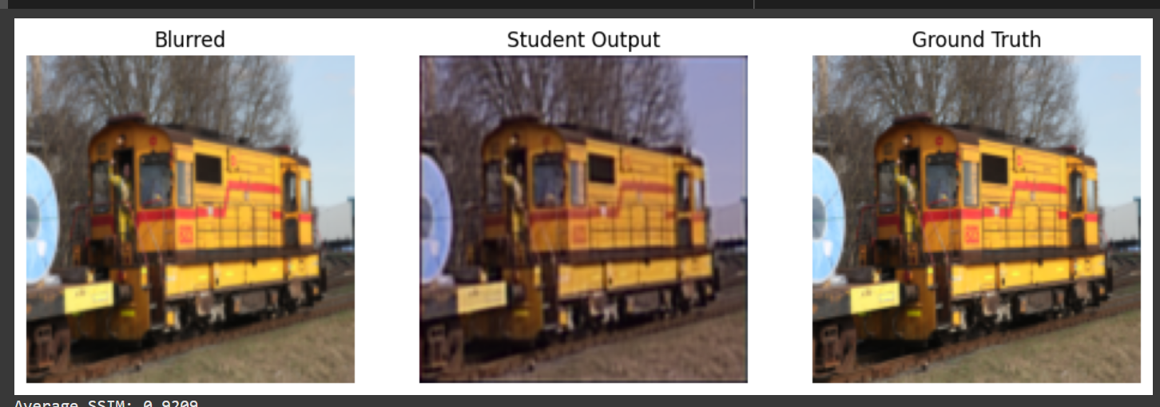
OUTPUT

Slide 10
Conclusion
Demonstrated that Knowledge Distillation enables high-quality
sharpening using lightweight models
Achieved SSIM ~0.92 with a small CNN trained on just 42 images
The student can be deployed on low-resource devices effectively

